Slide 1


ECEN 404
Team #44
Biweekly Update 1
Cubesat EM Material Discharge Eval:
Ian Poynter
Joshua Feldman
Michael Kim
Alejandro Torres
Sponsor: Orbital Arc & SATOP
TA: Souryendu Das

Slide 2
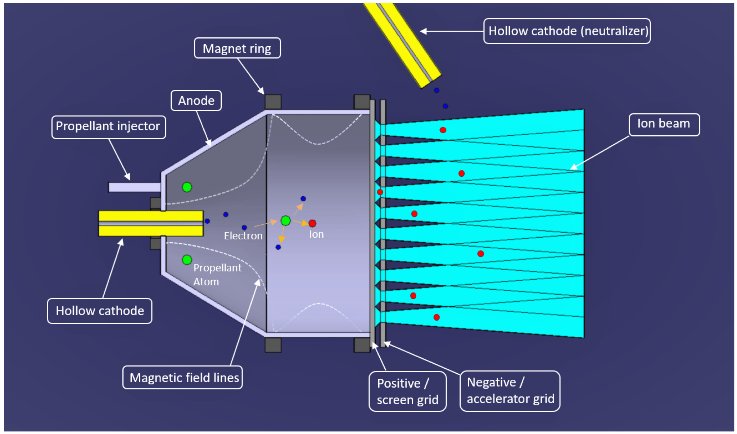
Problem: Current Ion Thrusters
Require expensive fuel
Extremely low acceleration
Require electron bombardment for ionization

Slide 3
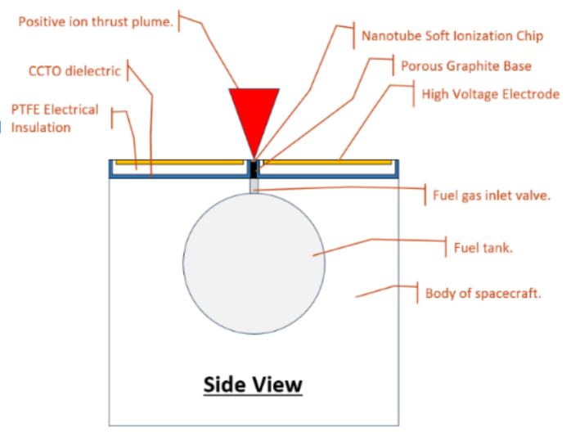
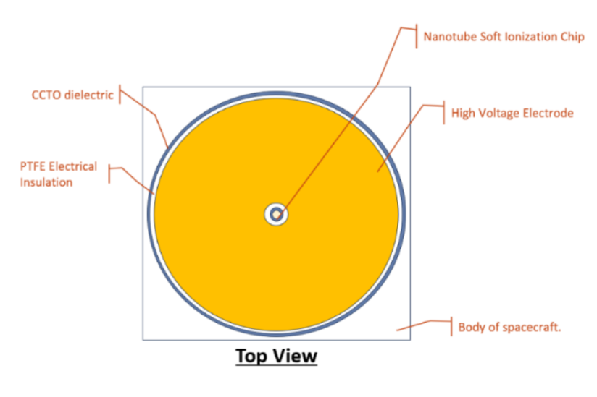
RIOT Drive
Develop a prototype for the RIOT Drive
Uses cheaper fuel
Will operate at about 4 times the efficiency of contemporary ion thrusters

Slide 4
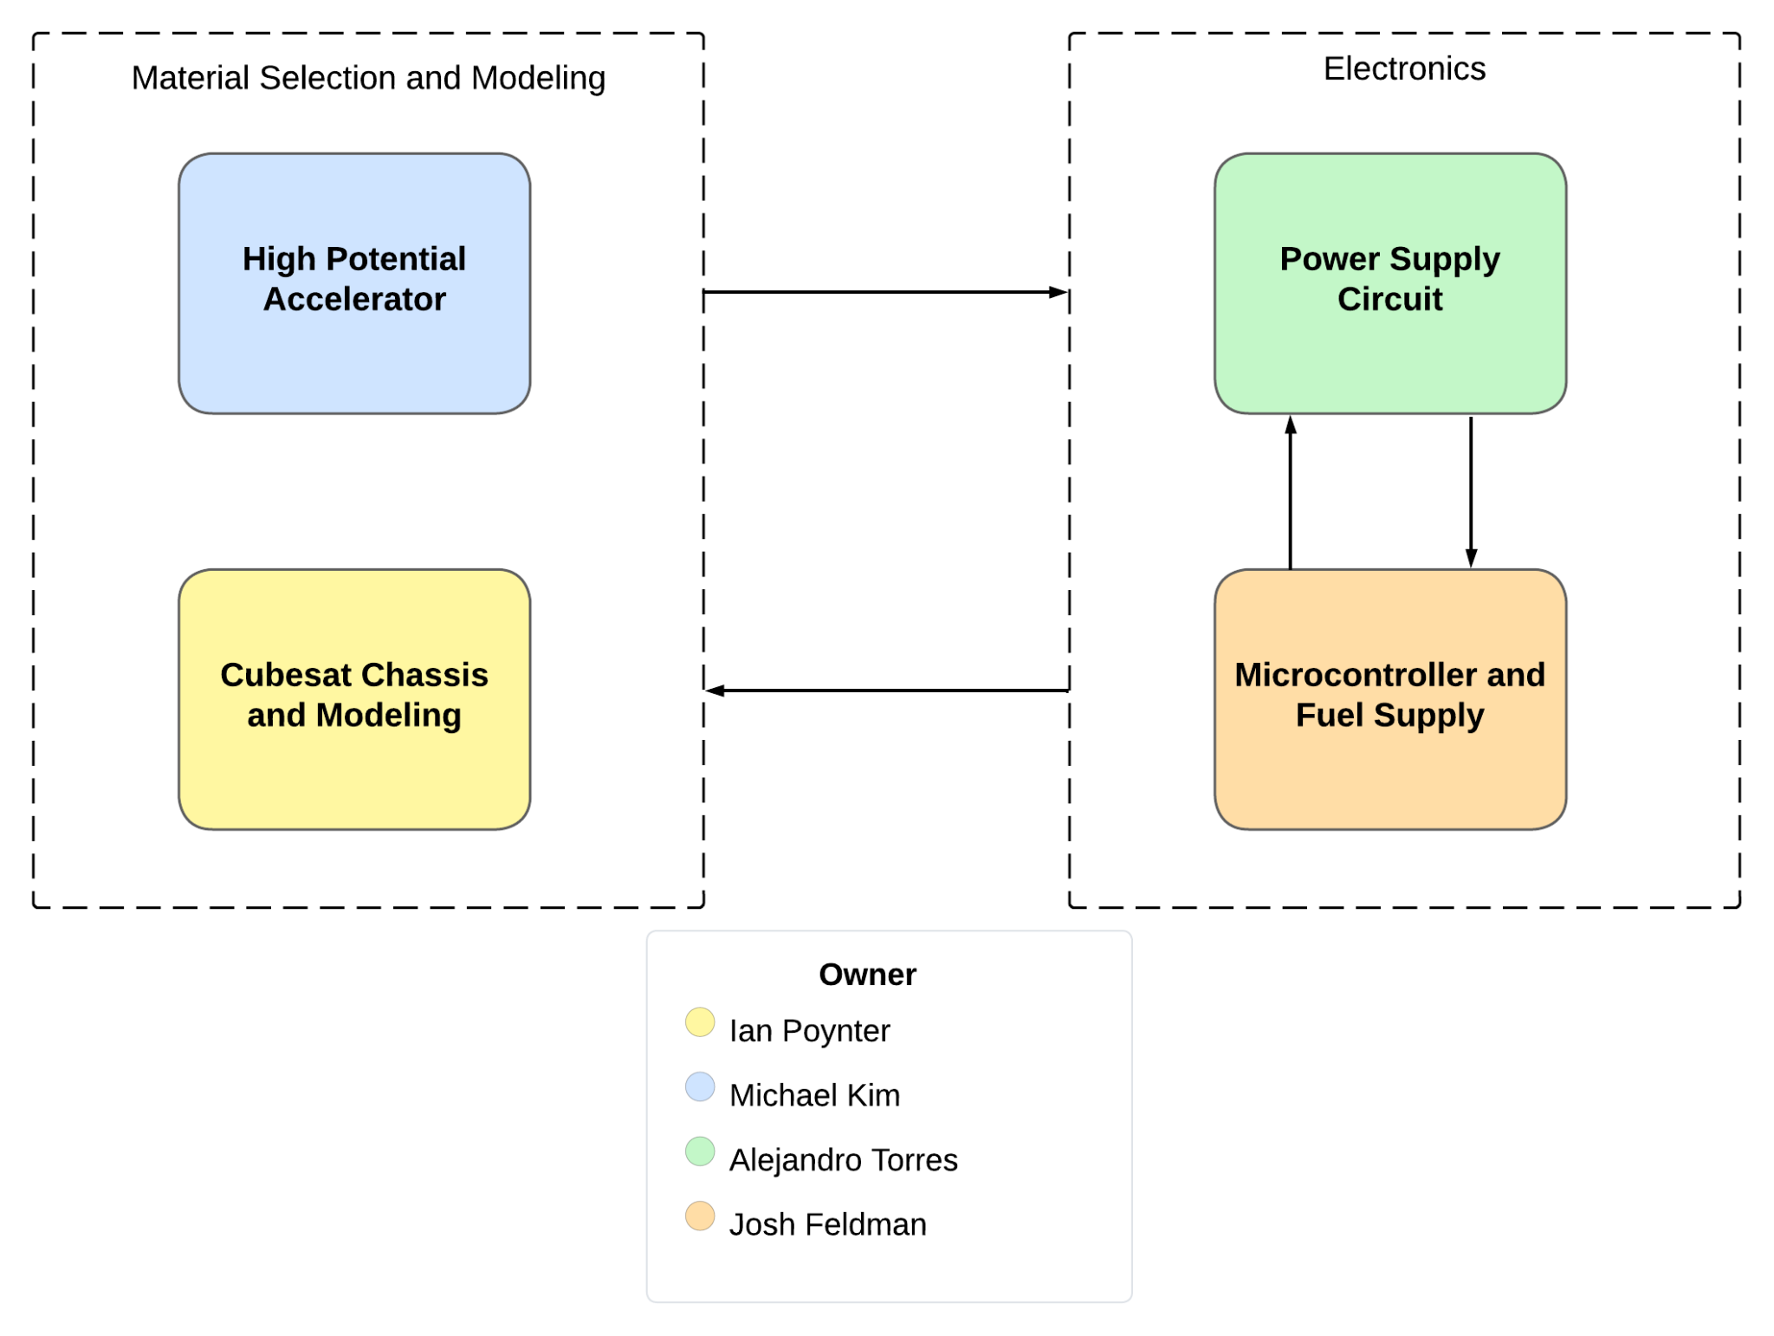
Diagram of Subsystems and Interface

Slide 5
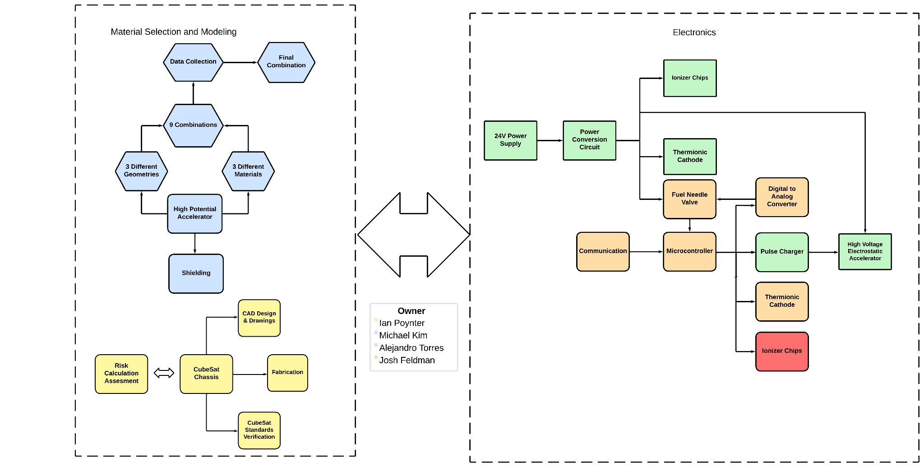
System Block Diagram

Slide 6
Major Project Changes
Alejandro - Problems faced with the PCB and Boost output voltage changed.
Josh - Adding gas flow controller controlled by microcontroller.
Ian - Working on lower voltage physical testing with prototype plates
Michael - Doing high voltage simulations on each plate geometry

Slide 7
Power Subsystem
Alejandro
Accomplishments since 403 4 hrs | Ongoing progress/problems and plans until the next presentation
Tested buck converter through electronic load | Boost Converter Output changed to 48V A Buck converter with the output of 5V. Find and simulate a new boost configuration and import design to Altium Designer. Print Circuit Board

Slide 8
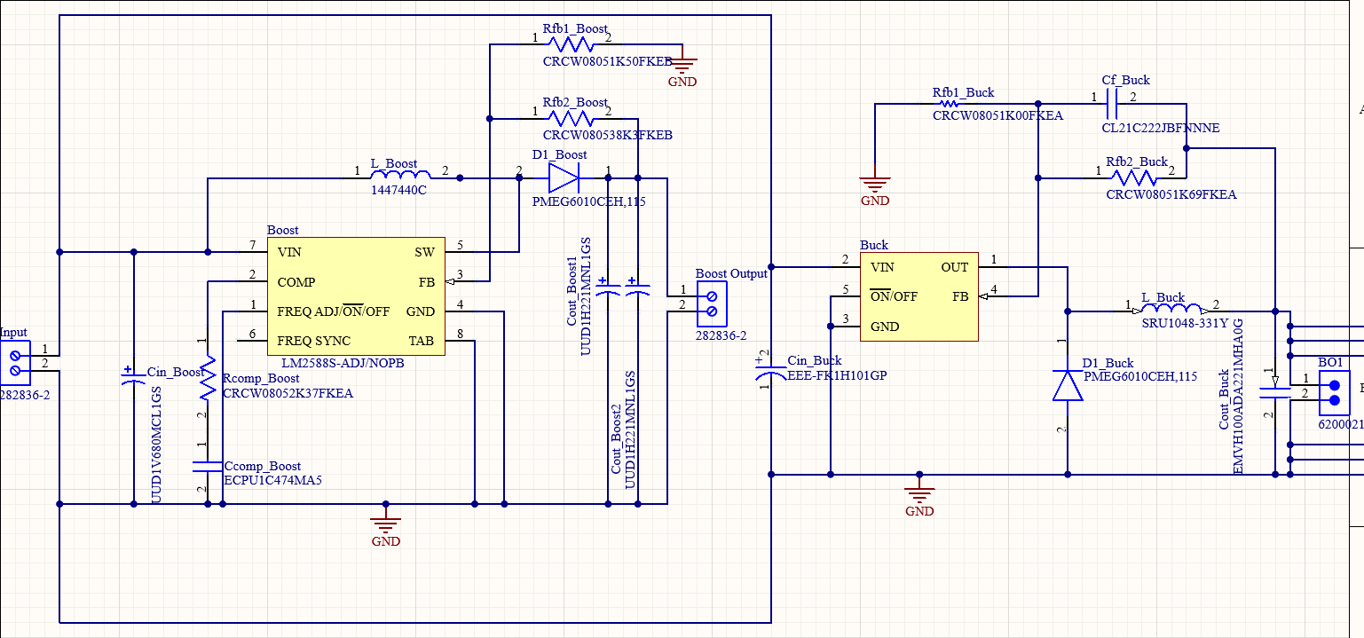
Power Subsystem Circuit
Alejandro Torres

Slide 9
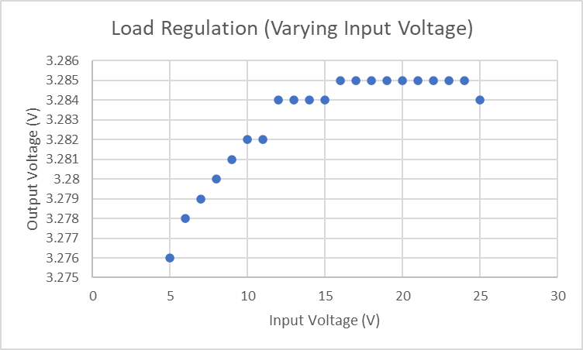
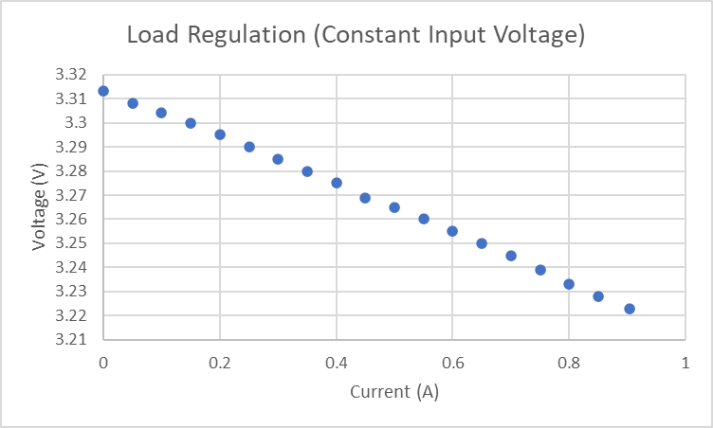
Power Subsystem
Alejandro Torres
Buck Converter tested through electronic load
3.3V was kept constant all throughout as output current changed and input voltage changed.

Slide 10
Microcontroller
Joshua Feldman
Accomplishments since 403 15 hrs of effort | Ongoing progress/problems and plans until the next presentation
Microcontroller circuit is back to operating level from the end of 403. Circuit redesigned to function with 5V instead of 3.3V. Worked with sponsor to clarify requirements for gas flow controller. Recoding and troubleshooting SPI code. | Working with Alejandro to integrate microcontroller and power supply circuits. Fix SPI not functioning. Research and order a gas flow controller.

Slide 11
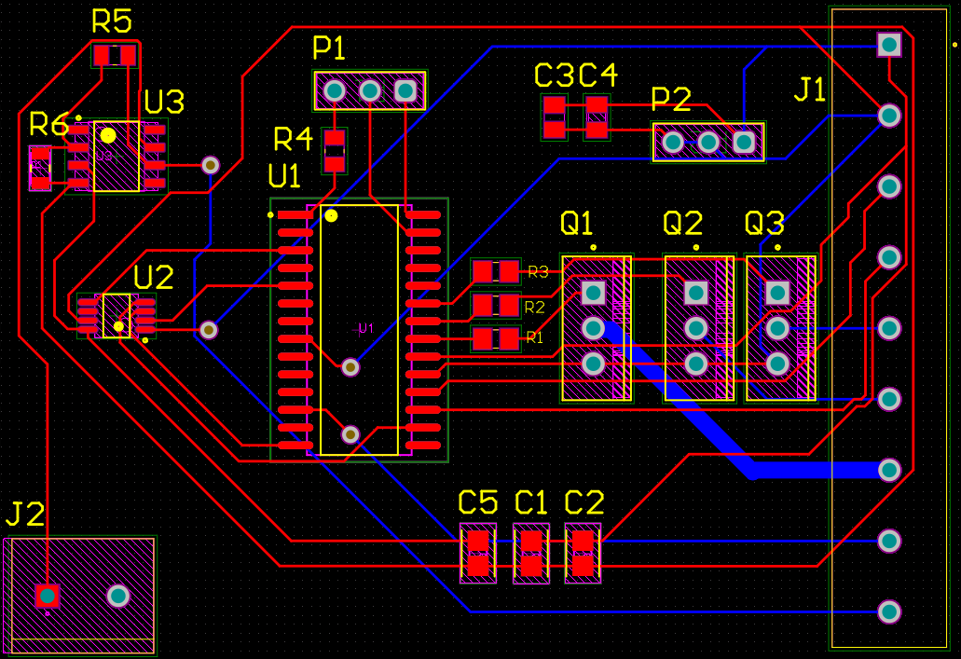

Slide 12
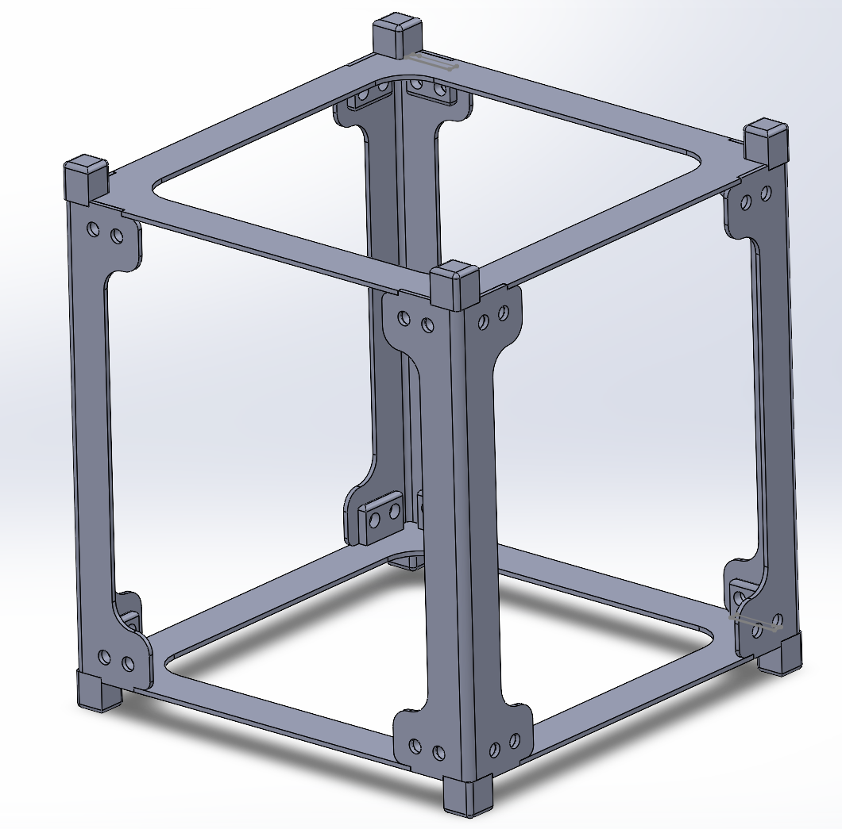
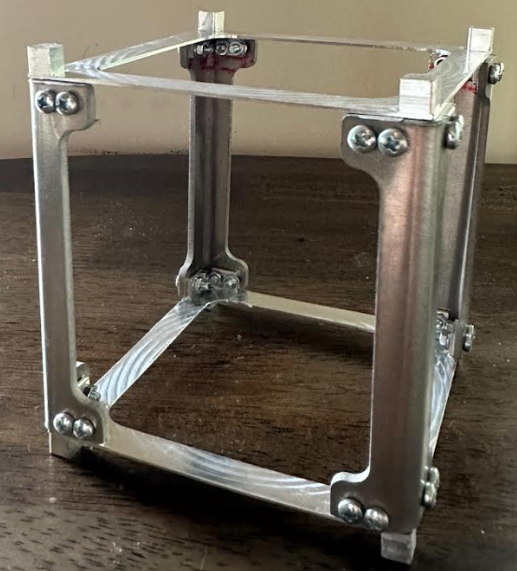
Low Voltage Physical Testing
Ian Poynter
Accomplishments since 403 3 hrs of effort | Ongoing progress/problems and plans until the next presentation
Chassis fabrication was completed in 403 Worked with sponsor to define objectives for lower voltage testing | Design testing procedure for accelerator plates Order parts to allow for testing

Slide 13
High Potential Accelerator Plate
Michael Kim
Accomplishments since 403 4 hrs of effort | Ongoing progress/problems and plans until the next presentation
Geometry-material prototypes are fabricated. Discussed high-voltage testing with sponsor. | Establish high-voltage simulation procedure to find electric field for prototypes. Perform simulations for circular plate geometry.

Slide 14
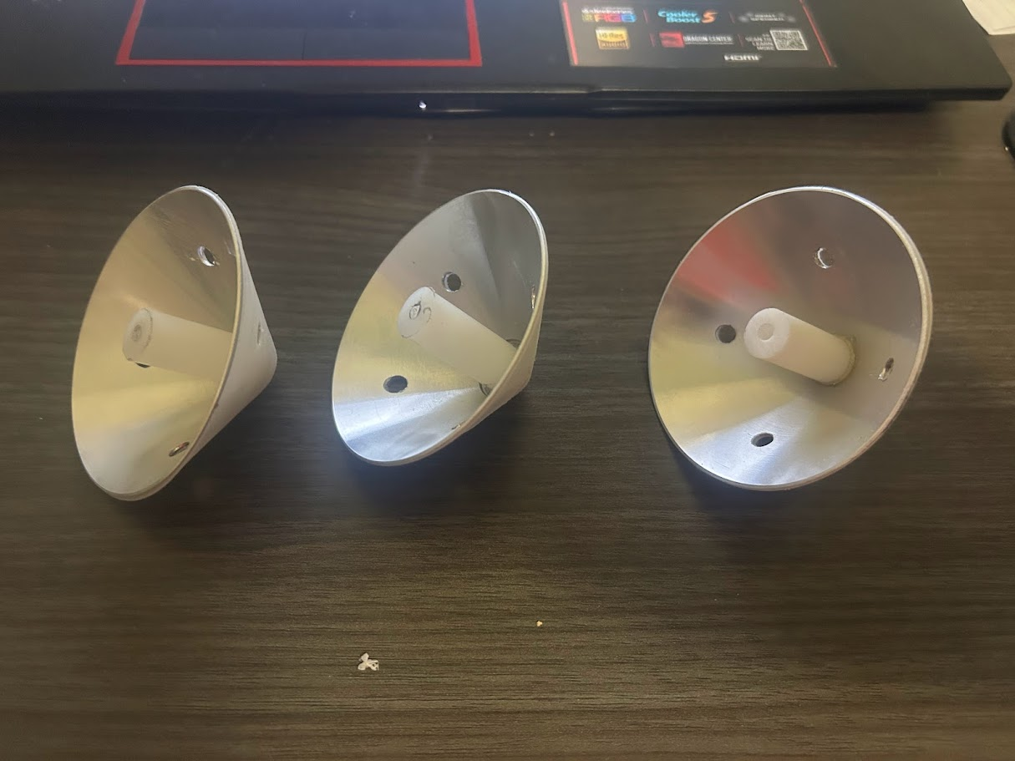
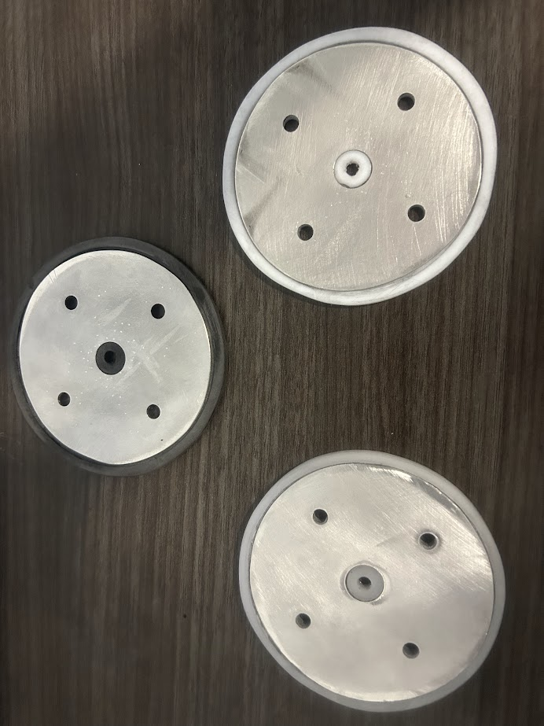
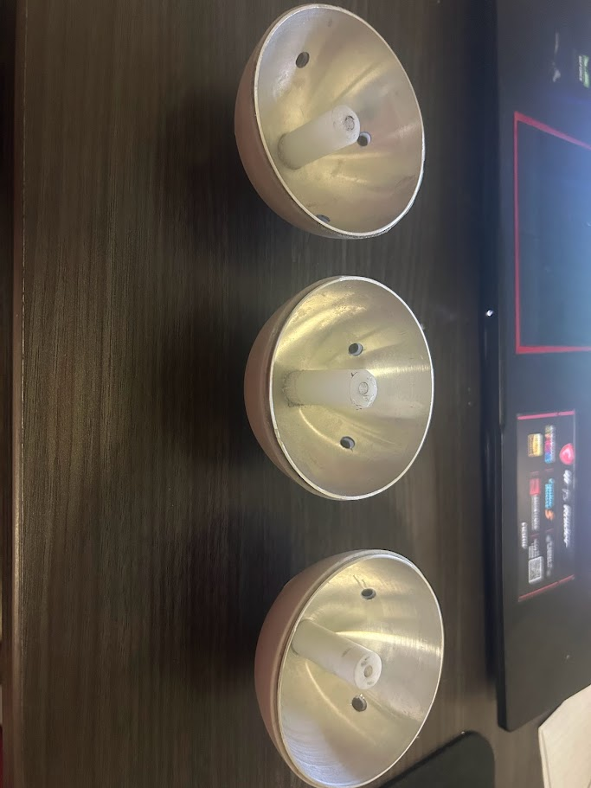

Slide 15
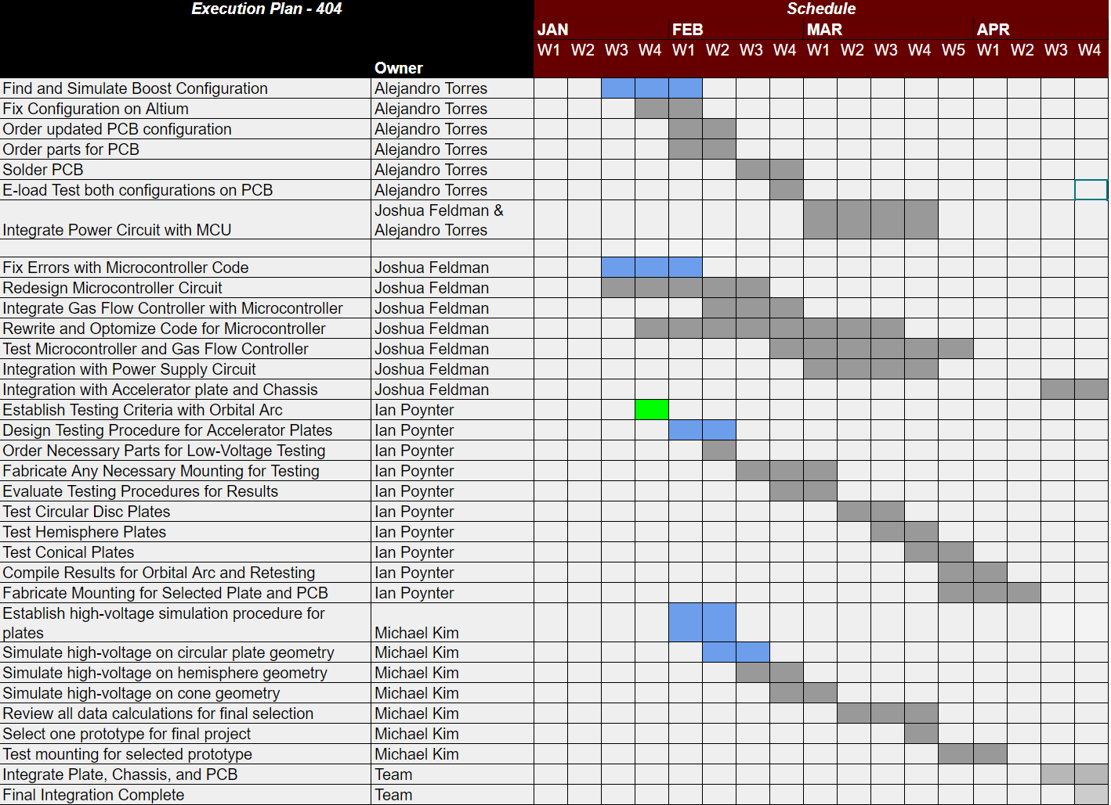
Execution Plan
Notes:
Michelle

Slide 16
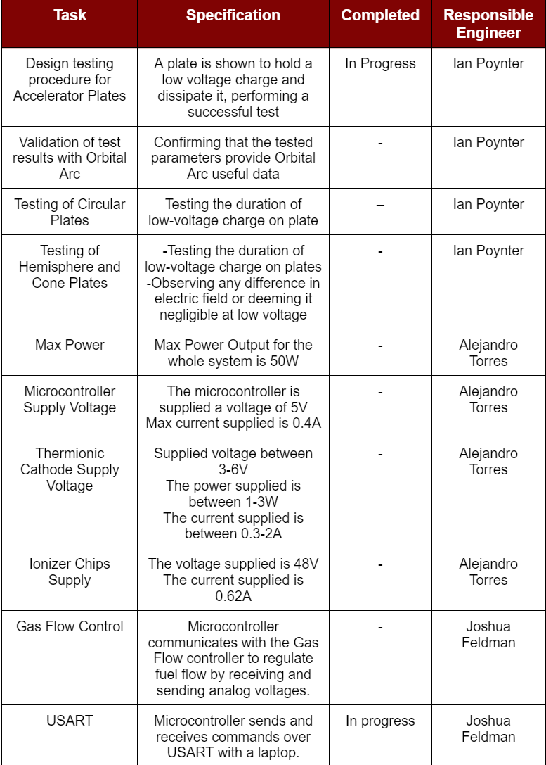
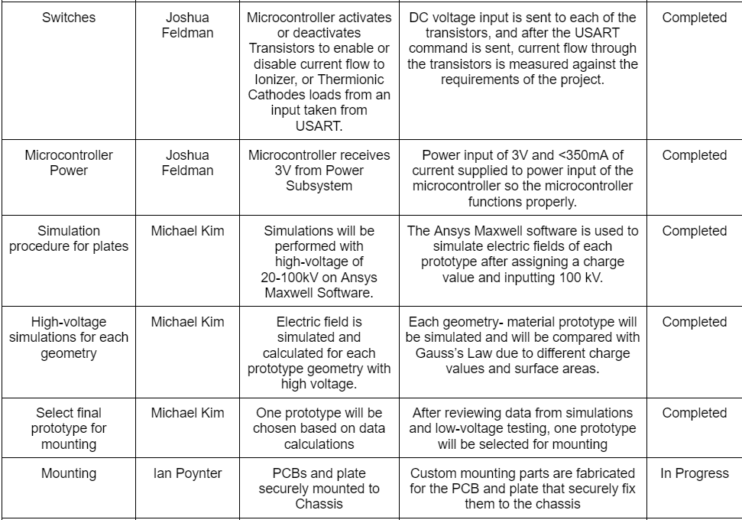
Validation Plan

Slide 17
Thank you!

